Slide 1
A discussion of numerical methods for capturing discontinuities in PDEs
with an introduction to GPU programming
Sean Davis
Will Matern
Slide <number>

Slide 2
Outline
Motivation
Discontinuities
Problems observed in numerical methods
Description of methods reviewed
  Lax-Wendroff with limiters
  MPDATA
  MUSCL
  SUPG
Results
  2D Advection Equations
GPU Programming
Conclusions
Slide <number>

Slide 3
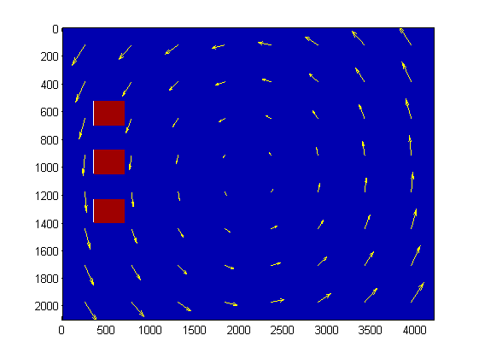
Motivation
The recent disaster in Japan caused a release of radioactive material into the Pacific Ocean. The idea of tracking these flows and accurately resolving the interfaces between the radioactive and non-radioactive water provided motivation for this research.
Slide <number>

Slide 4
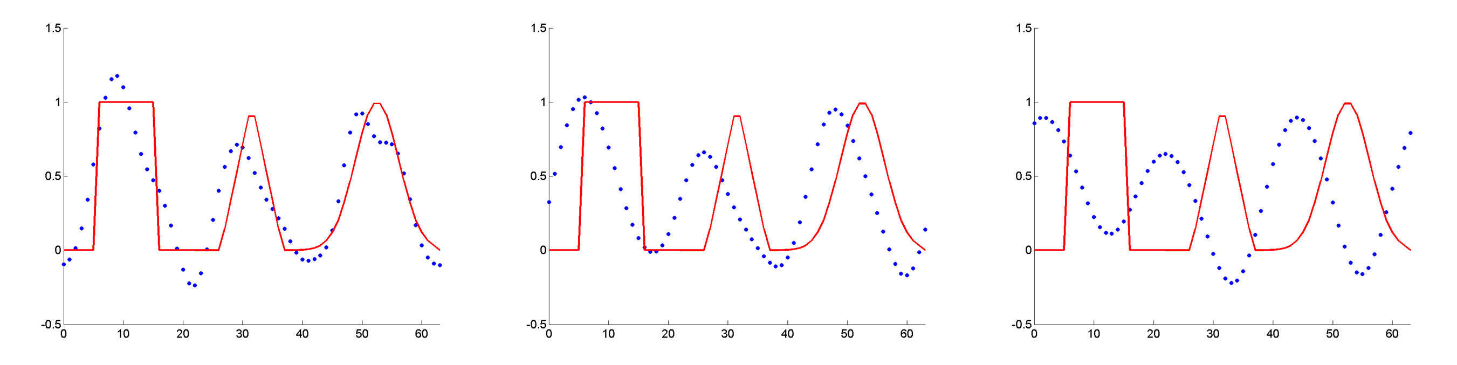
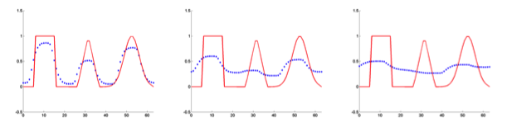
Problems observed in numerical methods for equations with discontinuities
Oscillations – High Order schemes
  Ex) Lax-Wendroff
Large dissipation – First Order Schemes
Slide <number>

Slide 5



Derivation of Lax-Wendroff for advection equation
Advection Equation:
Note that:
Replace the first two time derivatives with spatial derivatives
Remove 3rd order terms and above, and use central difference formulas:
Slide <number>

Slide 6

Derivation of Limiters
Slide <number>

Slide 7
Descriptions of methods reviewed
Lax-Wendroff w/o Limiters
  Conservative 2nd order scheme
  Approximate solution has oscillations around sharp gradients
Slide <number>

Slide 8
Description of methods reviewed
Lax-Wendroff w/ Limiters
  1st order near discontinuities, 2nd order elsewhere
  For linear equations is mathematically guaranteed to be TVD
Slide <number>

Slide 9
Description of methods reviewed
MUSCL
  ACM – Slope limiter method for sharpening discontinuities.
Slide <number>

Slide 10
Description of methods reviewed
Streamline Upwind Petrov-Galerkin (SUPG)
  Based on ideas from finite difference methods.
  Finite Element approach
  Applies to linear advection/diffusion equations of any dimension
  Petrov-Galerkin – Test functions are not the same as trial functions.
  In 1D is nodally exact. Higher dimensions are a heuristic generalization.
  Is not TVD
Slide <number>

Slide 11
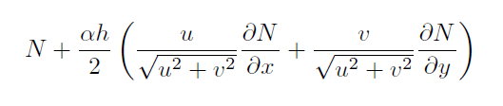
Theory of the Streamline Upwind Petrov-Galerkin (SUPG)
Trial functions – a set of functions assumed to approximate the underlying solution. The trial functions have degrees of freedom that must be solved for.
Test functions – a set of functions used to solve for the degrees of freedom of the trial functions. Uses the weak formulation of the governing equation.
Petrov-Galerkin – Test functions ≠ Trial functions
SUPG – Choose test functions to be:
where N is a trial function
Slide <number>

Slide 12
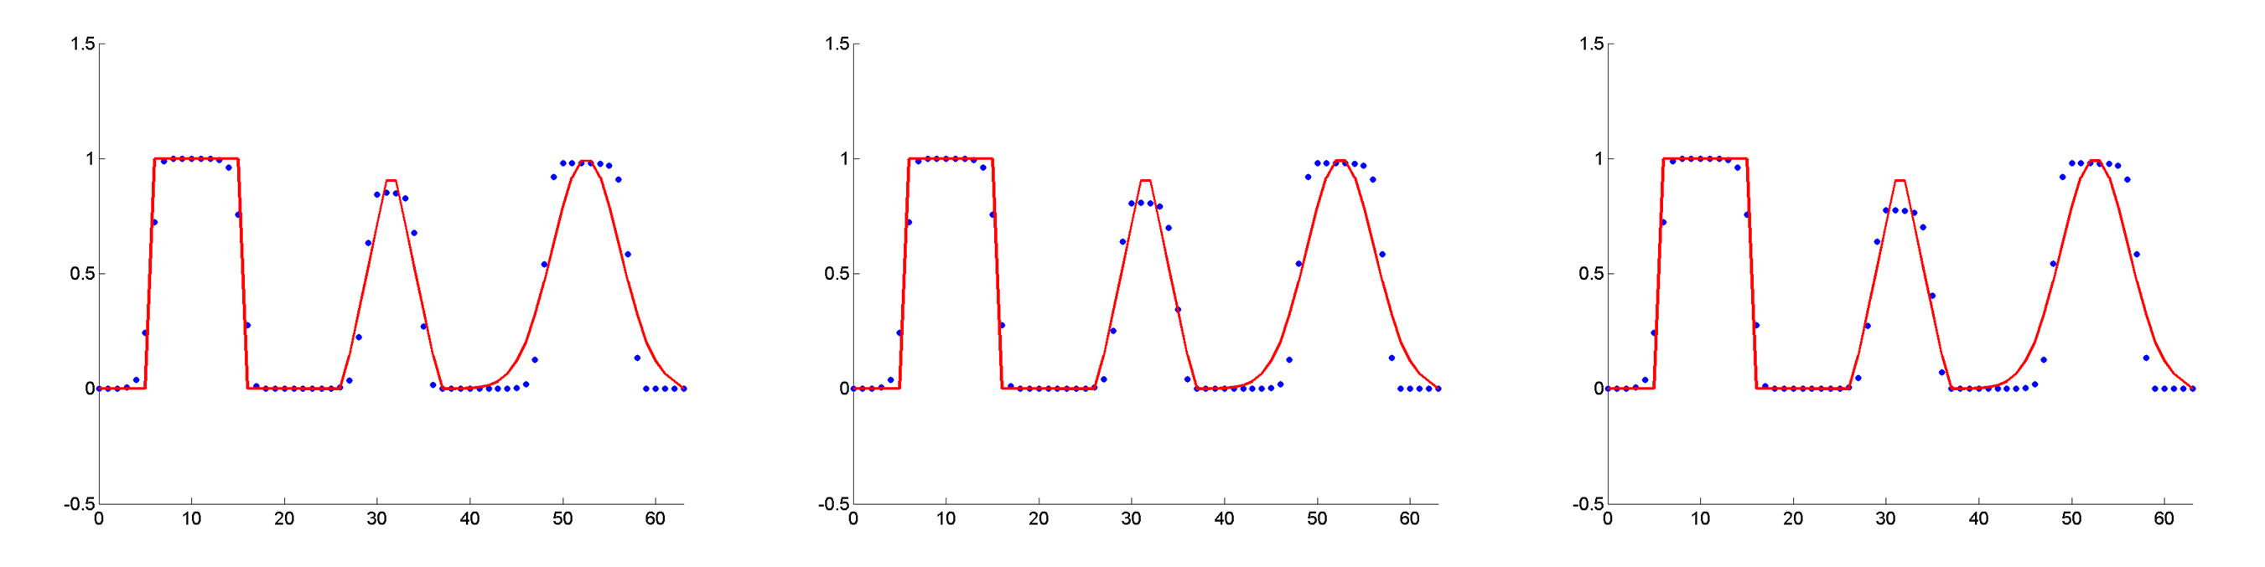
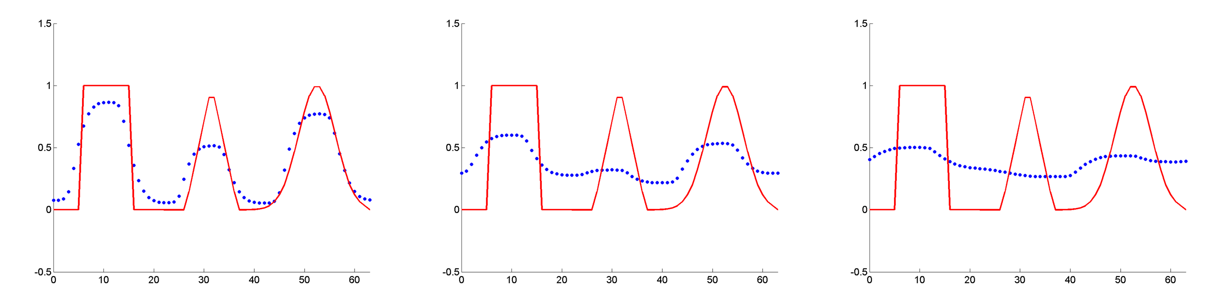
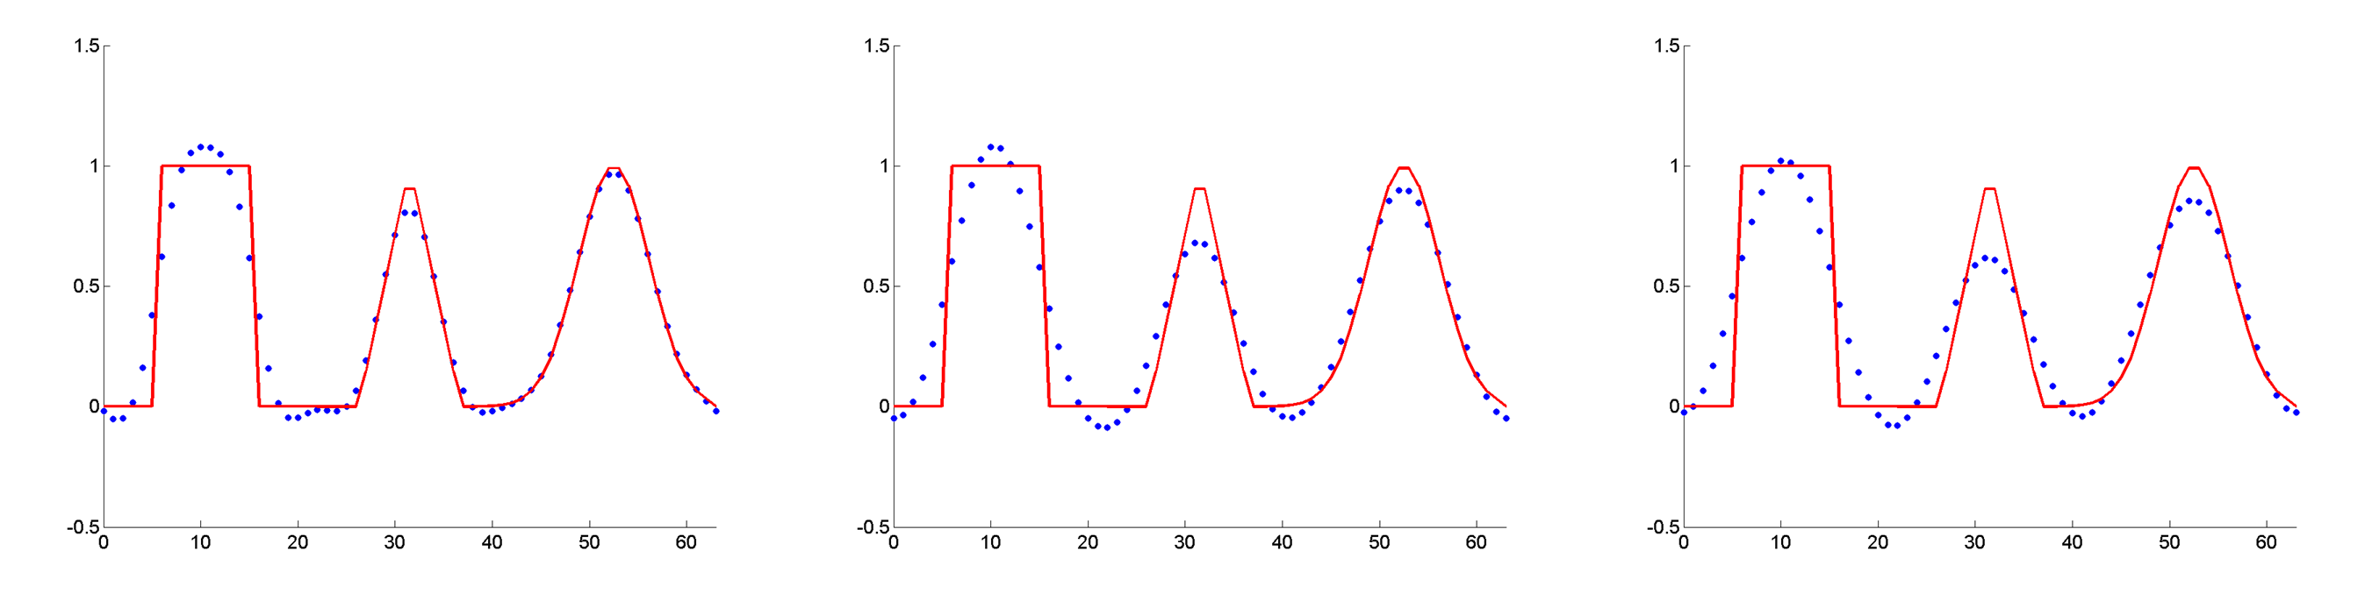
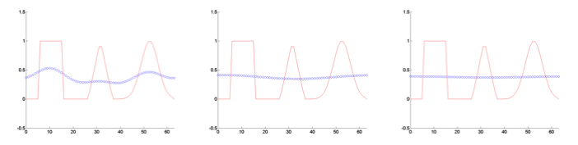
Results for 2D Advection
Lax-Wendroff (not TVD)
MUSCL
Lax-Wendroff (Superbee)
SUPG
MPDATA
Slide <number>

Slide 13
Description of methods reviewed
MPDATA
  One-sided bias donor cell approach
  Using a modified equation analysis, find an extra diffusive term
  Subtract out diffusive error using an anti-diffusive velocity
Slide <number>

Slide 14
GPUs at a glance
Different architecture from a CPU.
  Many low throughput processing units
  Cores all share memory
  Workgroups
Higher FLOPS (floating points operations per second) per dollar than CPUs.
Must use a language compiled for GPU
  OpenCL – Open programming language that can make use of multiple CPUs (on the same node) and a GPU. Can combine with MPI for multiple nodes.
  CUDA – Nvidia only.
Slide <number>

Slide 15
GPU architecture
Global Memory
  Available to entire device
Local Memory
  Available to the work group only
  ***I think this isn’t well defined in OpenCL and can spill over to Global without warning
Private Memory
  Available to work item only
Constant Memory
  Read only, can be faster than global
SIMD group size – efficient code is a multiple of this
  Nvidia – Warp size is 32
  ATI – Workgroup size is 64
  http://stackoverflow.com/questions/7093488/opencl-how-to-i-query-for-a-devices-simd-width
Slide <number>

Slide 16
Conclusions
MUSCL with ACM
  most effective for problems with discontinuities
  Unnaturally sharpens the solution
Lax-Wendroff with slope limiters
  Effective for sharp discontinuities
  Overly dissipative for thin waves (cuts off the top of the triangular/gaussian waves)
  more dissipative than other methods
SUPG
  Balances well between diffusion and discontinuity sharpness
  Doesn’t introduce unnatural sharpening
  Requires matrix operations
  Non-conservative
Slide <number>

Slide 17
Conclusions
MPDATA
  Options to control total variation (FCT) and
Slide <number>

Slide 18
Future Directions
FEM approach for full Euler equations
Implement schemes for advection on the GPU (include in CLAMR)
Implement these schemes to solve the full Euler Equations
Alternative numerical methods
Slide <number>

Slide 19
Question, Comments, Suggestions?
Slide <number>

